Slide 1
DOROTA ZDYBAŁ
PRIMARY SCHOOL 82 IN CRACOW

Slide 2
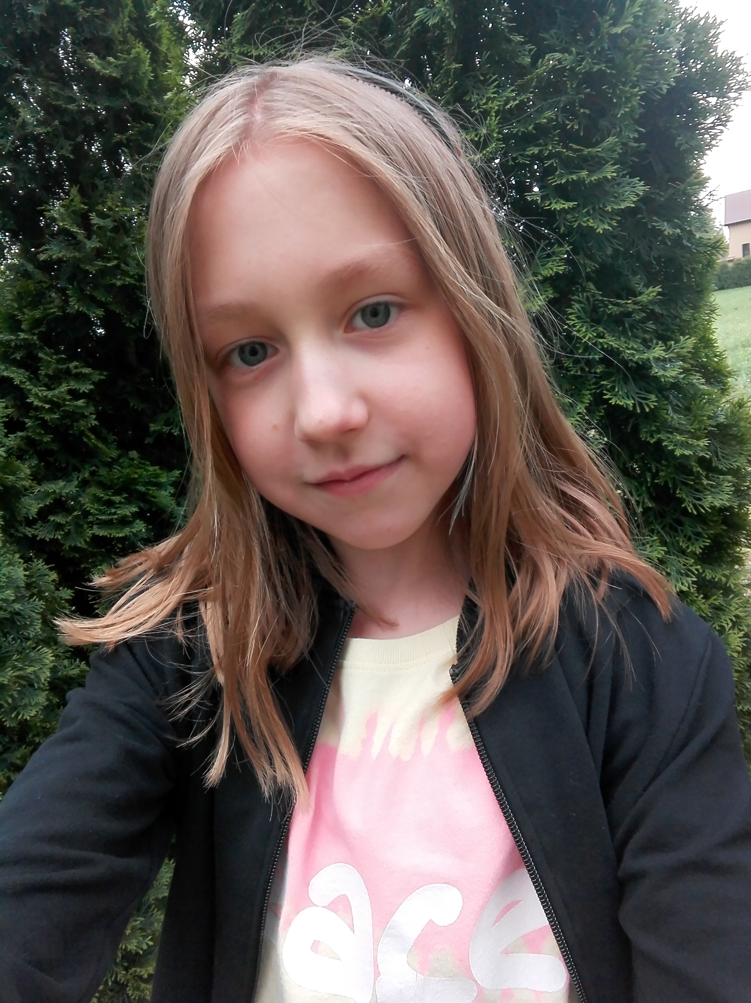
IT’S ME

Slide 3
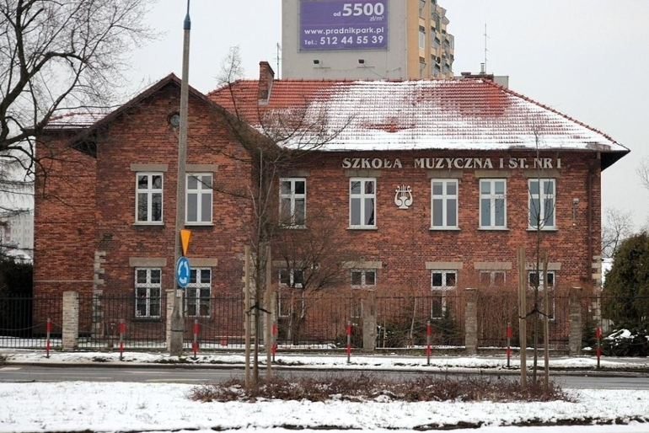
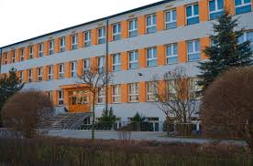
I GO TO SCHOOL EVERYDAY
Primary school Music school

Slide 4
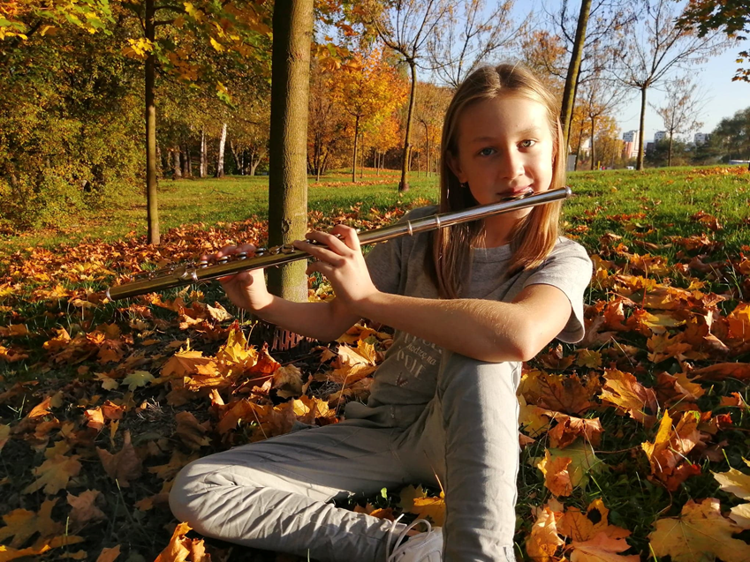
I LIKE TO PLAY THE FLUTE

Slide 5
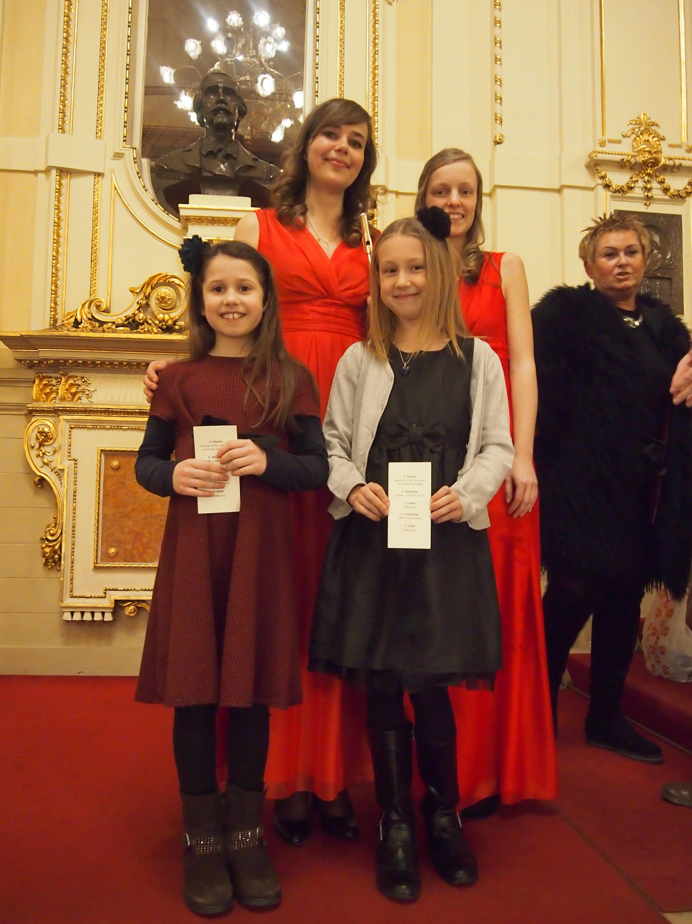
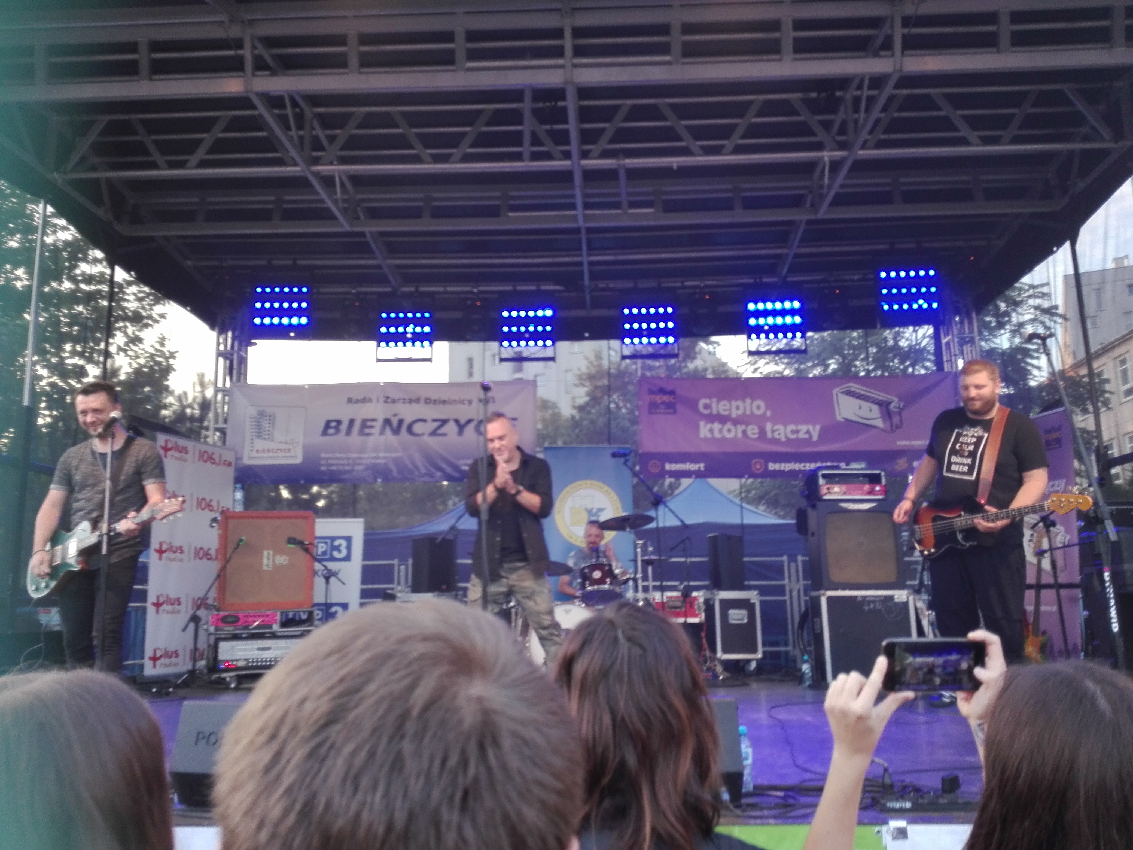
Sometimes
I go to theatre and to concerts

Slide 6
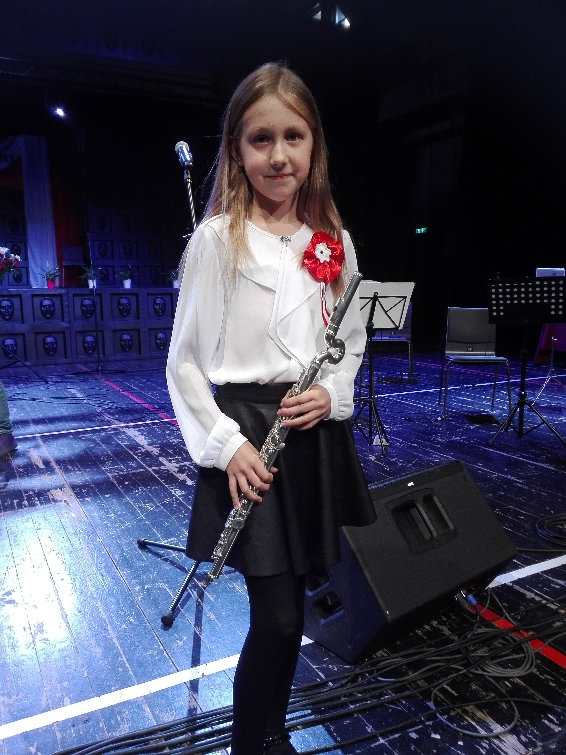
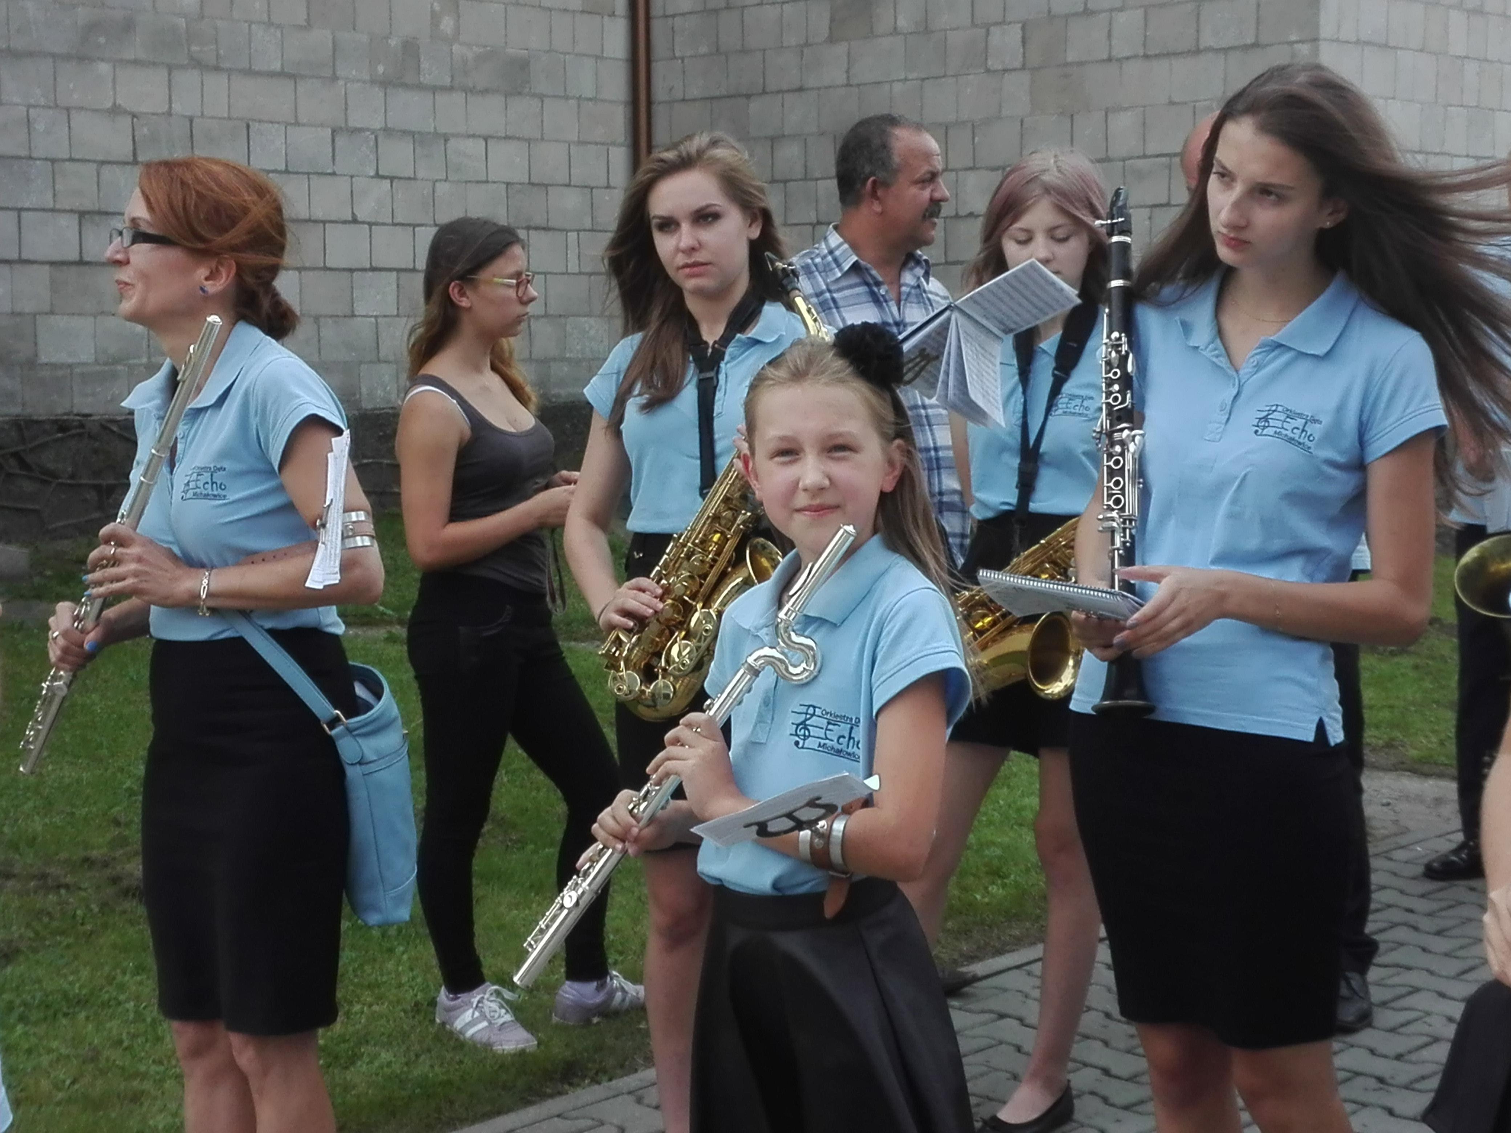
I play solo or with an orchestra

Slide 7
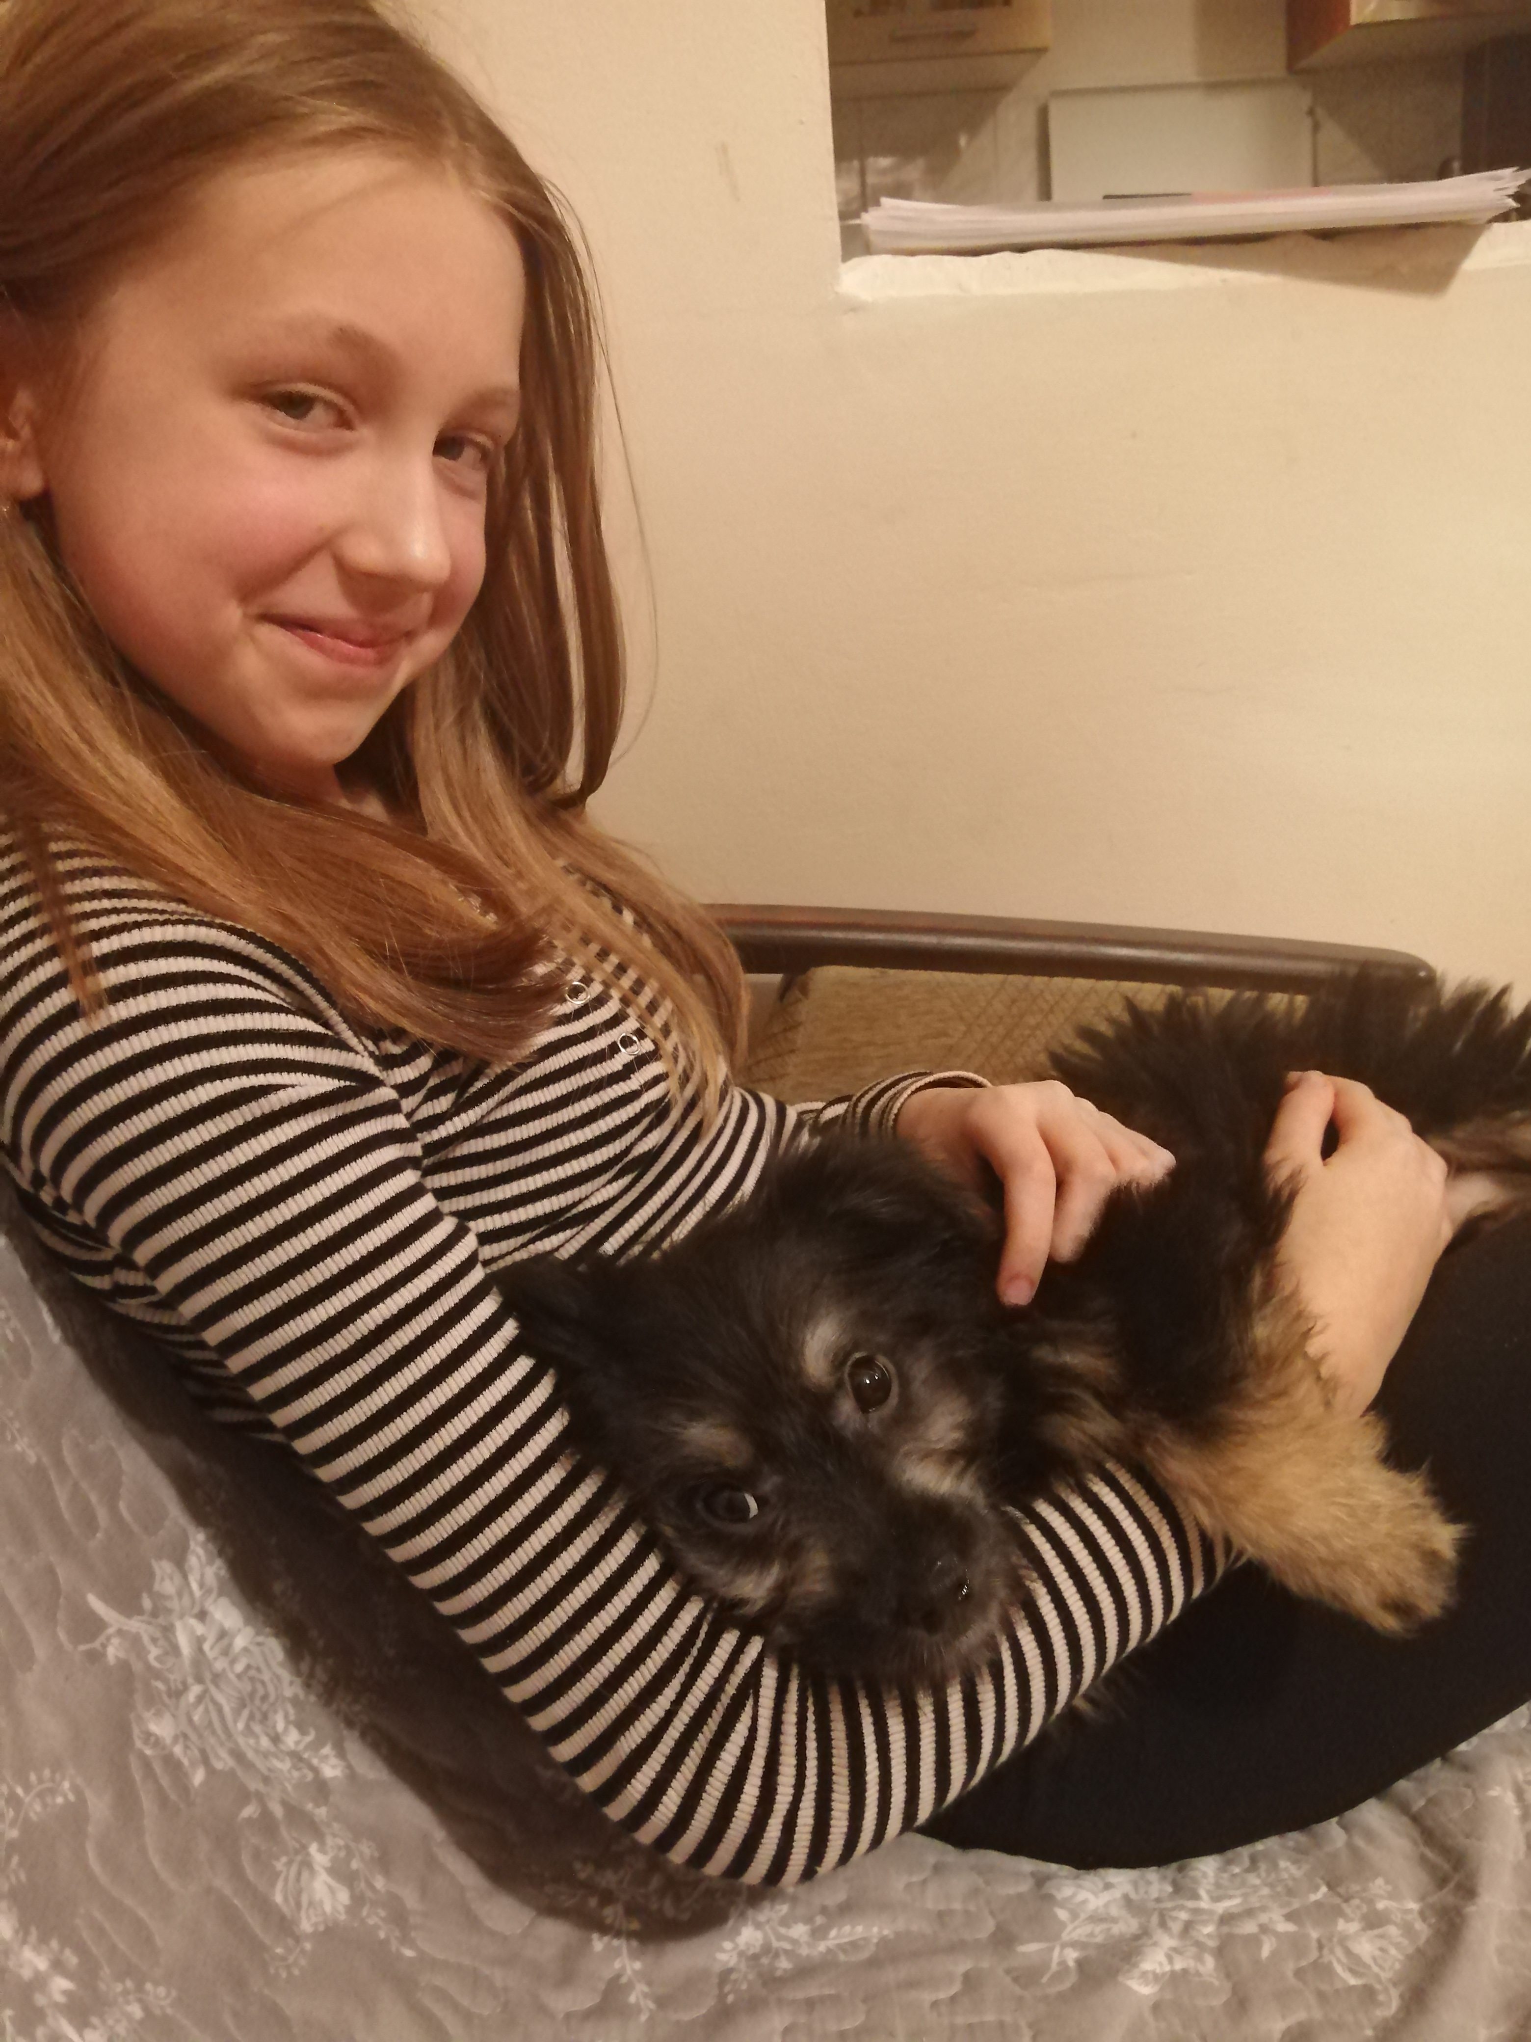
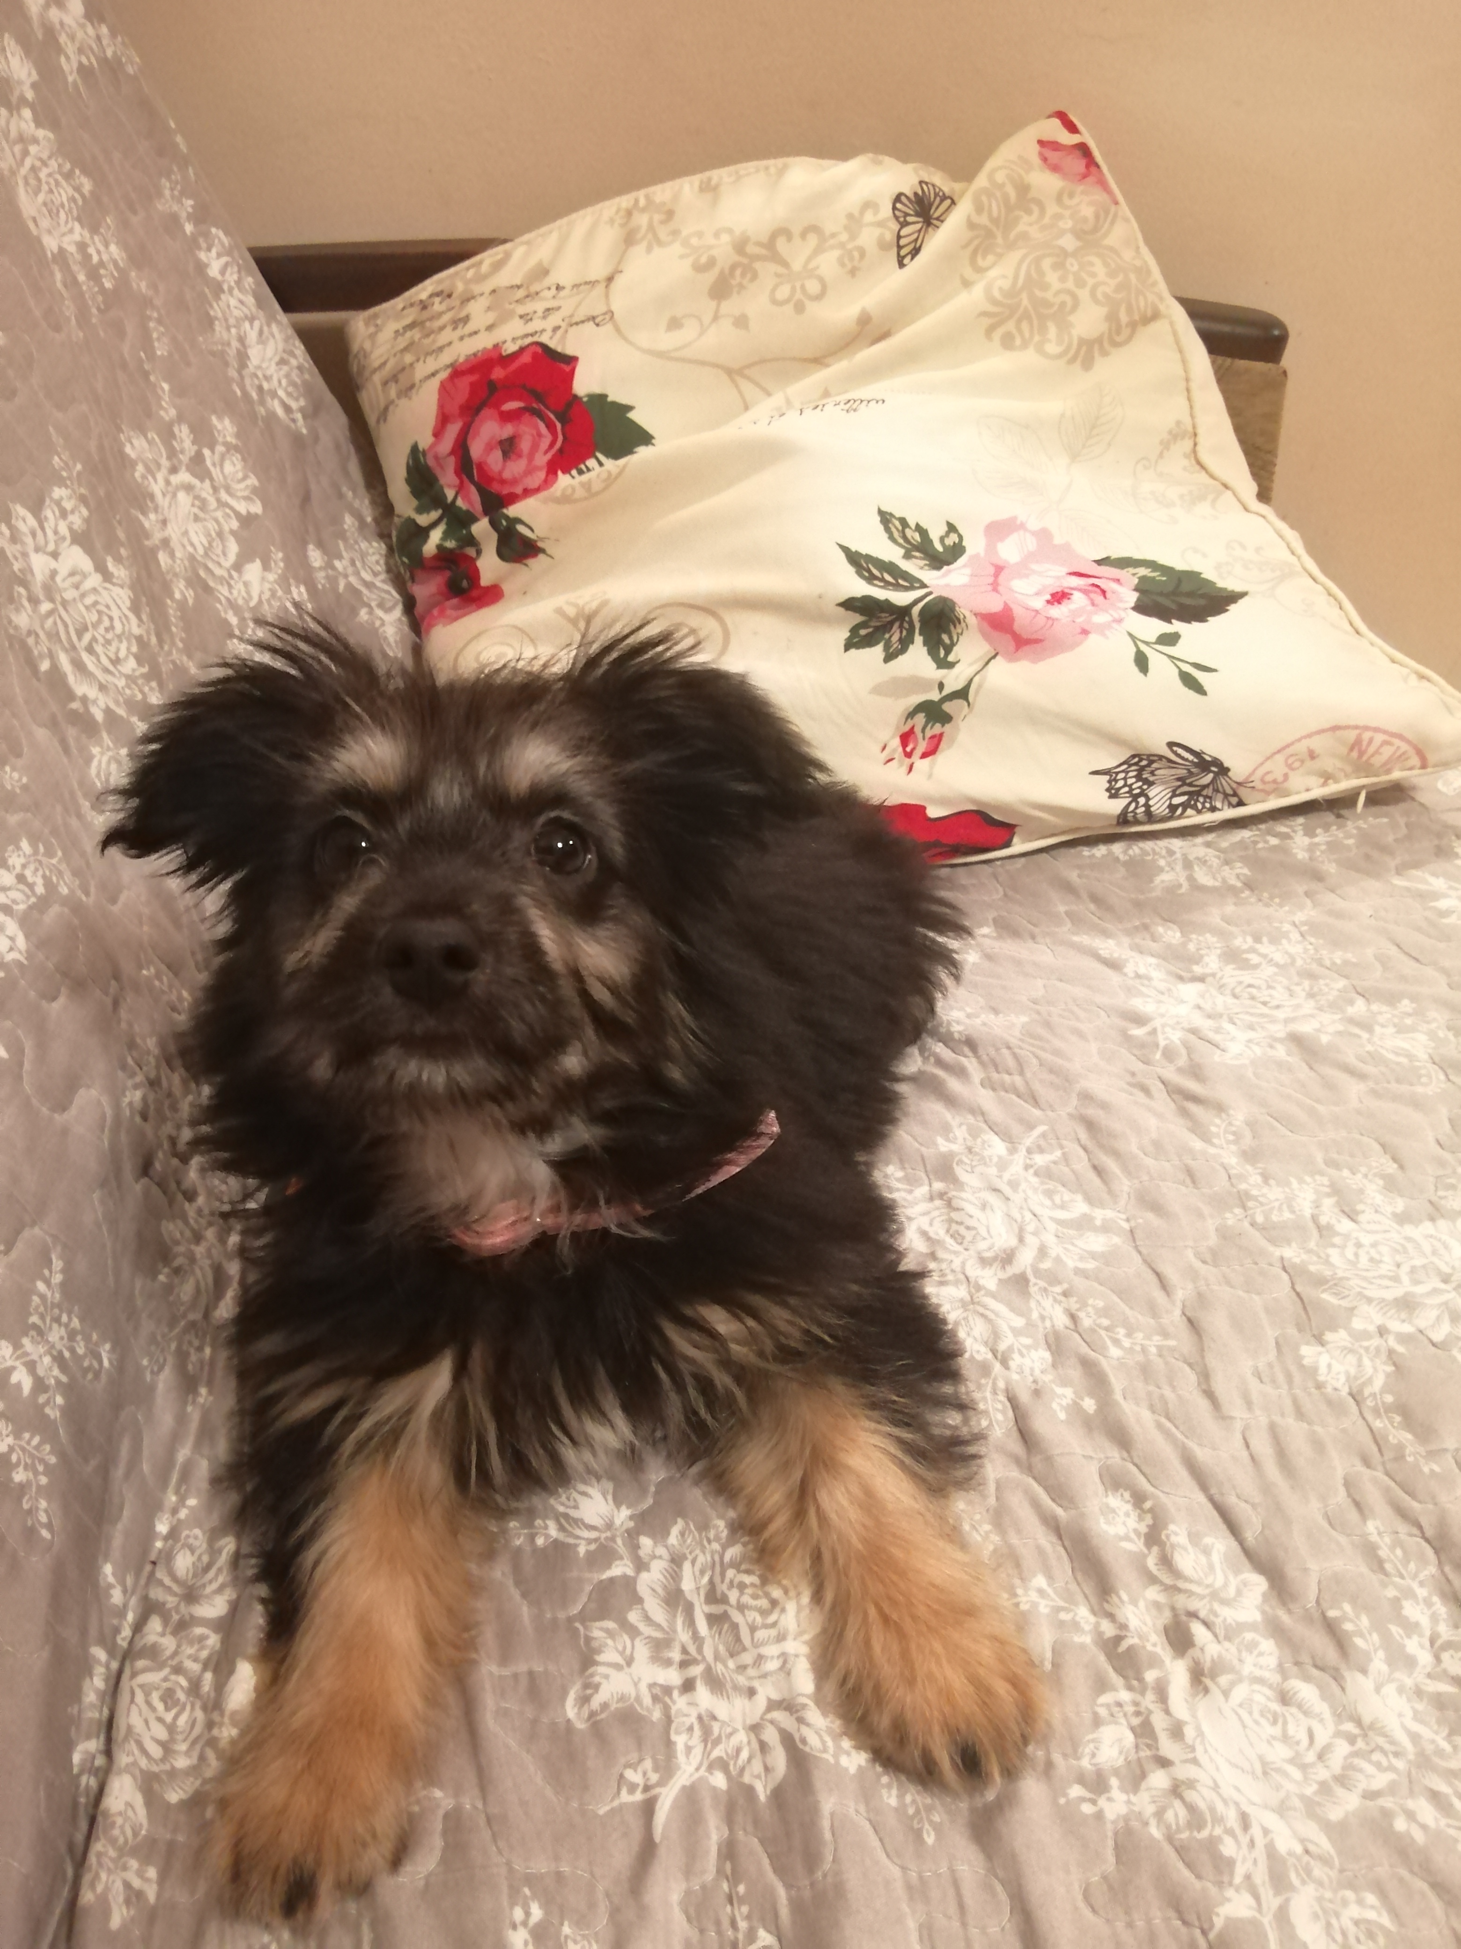
Everyday I go with my dog on the walk.

Slide 8
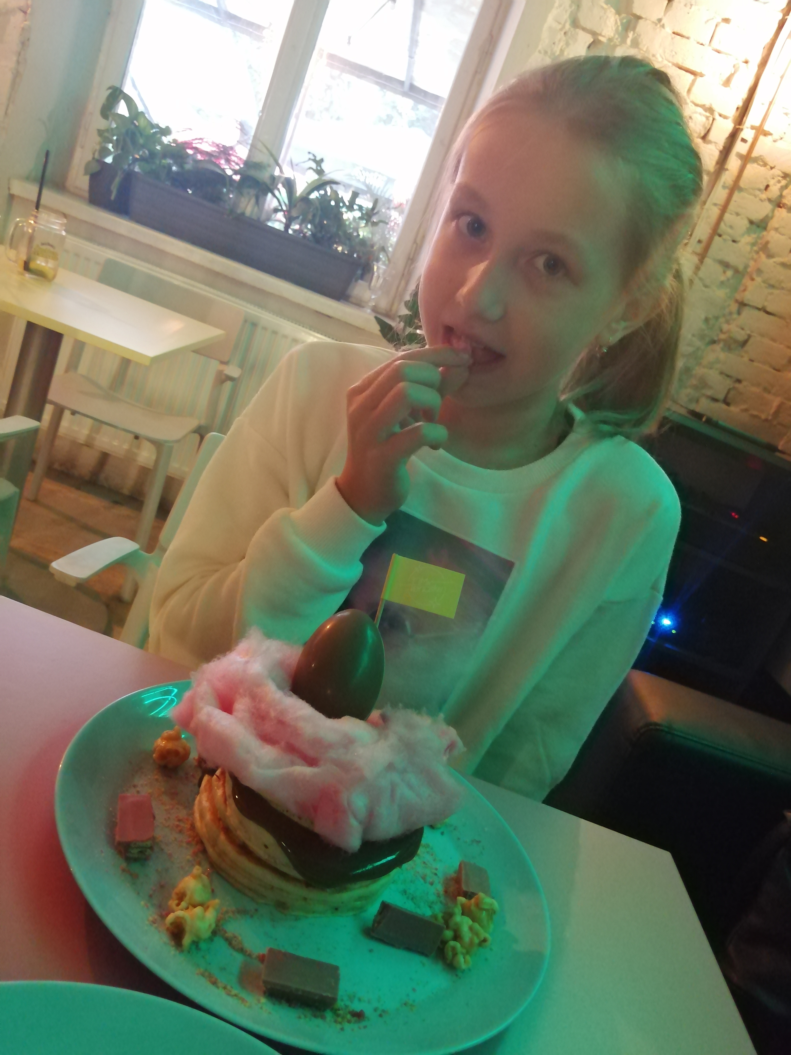
I like to eat big pancakes

